Slide 1
11693 Final Project Biomedical Question Answering System
Team 6
Rui Wang, Victor Zhao,
Carol Cheng, Hua Tang, Yan Zhao
Notes:
Welcome to watch the video report for Biomedical Question Answering System, which is done by 14Fall-Team6. In this video, I want to introduce the overall design architecture, the evaluation for the final results, and the further improvement that mainly base on our reviews so far.

Slide 2
Outline
Overview
Architecture
Performance
Improvement
Sprint Review
Notes:
The report video consists of five main parts have been shown up on the screen. The first four are mainly about the system functionality, combined with what we’ve learnt from the Design and Engineering of Intelligent information System, which are the Apache UIMA framework, and the theory of intelligent information system. Also, during the whole developing process, the scrum development process has been applied to maintain the progress of our development. We especially add multiple burndown charts and sprint back log for each iteration, which reflect our coherent developing process.

Slide 3
Overview - Objective
Build a biomedical question answering system
Answer yes/no questions
Question:
Is Mammaprint approved by the United States Food and Drug Administration?
Answer:
Yes
Notes:
First of all, let’s talk about objective. Our goal is to build a biomedical question answering system. Our system will generate a appropriate yes/no answer according to the input answer given by user. Take a look at the example below. If you typed into the question, Is Mammaprint approved by the United States Food and Drug Administraton, a “Yes” answer will be generated.

Slide 4
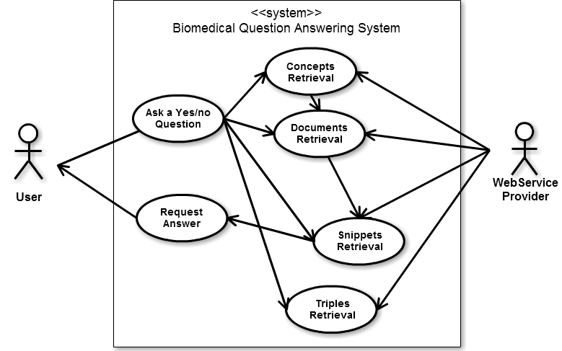
Overview - Use Case
Notes:
Now. From the software engineering perspective, the main interactions between user and system have been pointed out. Basically, there are two interactions between user and the system. Give the system the question and receive the answer from the system. Also, our QA system needs to interact with outside web service in order to collect the relevant Bio-medical information.

Slide 5
Overview - Milestones
Milestone 1
Concepts, documents, and triples retrieval
Milestone 2
Snippets retrieval
Milestone 3
Exact answer generation
Notes:
Furthermore, in order to maintain the progress for our system implementation. Three main milestones have been set at the first place. First, the minimum viable prototype should be able to retrieve the concepts, documents and triples based on the parsed question, which is the first step that help us to verify the feasibility of question understanding. Second, in order to generate the informative answer, lots of semantic data, we called snippets, also need to be generate, which will support the system come up with the correct answer in final stage. At the end, the exact answer, which is also the most critical part of our system, is about to be finished.

Slide 6
Architecture
Input
Questions
Collection Reader
ComplexQuery
(AND)
Annotator
Output Answers
Concept Annotator
Question
Annotator
ComplexQuery
(OR)
Annotator
Document
Annotator
Snippets Annotator
AnswerGen
Annotator
CAS consumer
ComplexQuery
(……)
Annotator
Triple
Annotator
Evaluation
Report
Atomic
Query
Complex
Query
Aggregate Analysis Engine
Notes:
The overall architecture is mainly based on the Apache UIMA framework. The Collection Processing Engine pipeline. First, the collection reader read into the question given by the user. Then, pass the question to the aggregate analysis engine and let annotator save the result into the common analysis system annotation. In the end, the cas consumer will produce the output answer and give back to the user.

Slide 7
Query Extraction
Question preprocessing
Remove punctuation
Remove stop words
Do stemming
Is Mammaprint approved by the United States Food and Drug Administration?
Question
AtomicQueryConcept
Mammaprint
approve
United
States
Food
Drug
Administration
Mammaprint AND approve AND United AND States AND Food AND Drug AND Administration
ComplexQueryConcept
Notes:
The most critical issue at the very first beginning, is to understand the meaning of question. Therefore, we apply serveral NLP techniques to process the question into query, convert the unstructured question into structured query and save these as annotation.

Slide 8
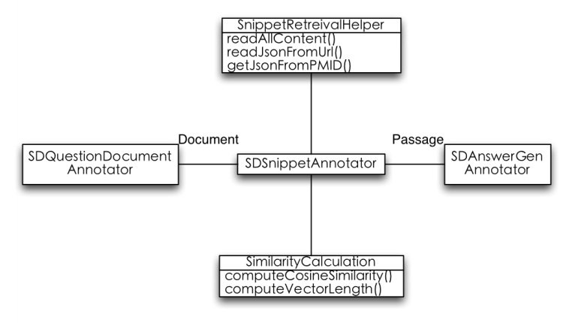
Snippet Retrieval
Two helper classes
Collect articles by the given documents
Calculate the similarity
Notes:
The second important component is to retrieve snippets, which play a critical role before the final answer generation. After the article has been collect from the web service according to the document identifer, the sentences have been trunked into different sentences aka the snippets. By calculate the similarity between original query and snippet, the ranked snippets have been generated and passed to AnswerGenAnnotator.

Slide 9
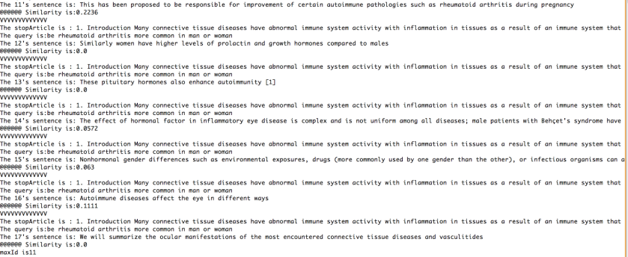
Performance--Milestone
Milestone 1
 | Concept | Document | Triple
MAP | 0.4699 | 0.0737 | 0.0000
GMAP | 0.0574 | 0.0026 | 0.0010
Total: 29 Questions
Milestone 2 – Snippet retrieval

Slide 10
Performance -- Query processing
Without eliminating stop words
 | Concept | Document | Triple
No concept score threshold
MAP | 0.4309 | 0.1117 | 0.0000
GMAP | 0.1227 | 0.0035 | 0.0010
Concept score > 0.1
MAP | 0.4511 | 0.0743 | 0.0000
GMAP | 0.0462 | 0.0023 | 0.0010
Concept score > 0.15
MAP | 0.4569 | 0.0743 | 0.0000
GMAP | 0.0399 | 0.0023 | 0.0010
Concept score > 0.2
MAP | 0.3046 | 0.0743 | 0.0000
GMAP | 0.0124 | 0.0023 | 0.0010
Total: 29 Questions

Slide 11
Performance -- Query processing
With eliminating stop words
 | Concept | Document | Triple
No concept score threshold
MAP | 0.4309 | 0.1117 | 0.0000
GMAP | 0.1227 | 0.0034 | 0.0010
Concept score > 0.1
MAP | 0.5043 | 0.1117 | 0.0000
GMAP | 0.0882 | 0.0035 | 0.0010
Concept score > 0.15
MAP | 0.4847 | 0.1117 | 0.0000
GMAP | 0.0502 | 0.0035 | 0.0010
Concept score > 0.2
MAP | 0.4502 | 0.1117 | 0.0000
GMAP | 0.0396 | 0.0035 | 0.0010
Total: 29 Questions

Slide 12

Performance--Overall
Summary:
After eliminating stop words, we got better performance.
Different concept score threshold result in different performances.
Finally, we choose to eliminate stop words and set concept score threshold as 0.1.

Slide 13
Improvement
Problems in our system
Low MAP in document
MAP of triple is 0

Slide 14
Improvement
Query Extension: Regenerate updated query text for document searching
Tighten terms in query text using lingpipe
Advanced combination strategy for received contents from different complex query concept annotators.
Adding concepts into query text, with different operators, to search document and triple.

Slide 15
Improvement
Document ranking: re-rank received documents to improve precision of documents and for snippet retrieval.
Original received documents did not arrange in reasonable ordering.
Try different ranking strategy and order documents in reasonable ranking.
Notes:
For example, BM25

Slide 16
Sprint Review

Slide 17
Scrum Product Backlog
ID | Story | Estimation | Priority
1 | As a user I can input yes/no biomedical questions to the system | 5 | 1
8 | As a user I can get yes/no answers from the system | 5 | 1
7 | The system can generate exact answers | 12 | 1
9 | As a user I can get the evaluation of the answers | 15 | 2
2 | The system can process the questions | 20 | 3
3 | The system can retrieve concepts from web services | 15 | 4
4 | The system can retrieve documents from web services | 15 | 4
6 | The system can retrieve snippets by the given documents | 20 | 5
5 | The system can retrieve triples from web services | 10 | 6
Total |  | 117

Slide 18
Sprint Backlog - 1
ID | Story | Tasks |  | Time (Est)
1 | As a user I can input yes/no biomedical questions to the system | Save questions as JSON file |  | 5
8 | As a user I can get yes/no answers from the system | Retrieve answers from JSON file |  | 5
7 | The system can generate exact answers | AnswerGen Annotator | Retrieve the top 5 snippets of a question and decide the answer to be yes/no | 12
9 | As a user I can get the evaluation of the answers | CASConsumer | Generate a evaluation report and output the answers as a JSON file | 15

Slide 19
Sprint Backlog - 2
ID | Story | Tasks |  | Time (Est)
2 | The system can process the questions | CollectionReader | Read questions from a JSON file | 2
 |  | Question Annotator | Remove punctuations from questions | 1
 |  |  | Tokenize questions by white-spaces | 1
 |  |  | Do stemming on tokens | 2
 |  | ComplexQuery Annotator | Combine AtomicQueryConcept to a query string | 6
 |  | ComplexQuery ANDAnnotator | Combine AtomicQueryConcept by adding “AND” operater to produce ComplexQueryConcept | 8
3 | The system can retrieve concepts from web services | Concept Annotator | Use web services to process ComplexQueryConcept and retrieve concepts | 15

Slide 20
Sprint Backlog - 3
ID | Story | Tasks |  | Time (Est)
4 | The system can retrieve documents from web services | Document Annotator | Use web services to process ComplexQueryConcept and retrieve documents | 15
6 | The system can retrieve snippets by the given documents | SnippetRetrievalHelper | Retrieve biomedical articles by the given documents | 5
 |  | Similarity Calculation | Calculate cosine similarity between query string and snippets | 5
 |  | Snippet Annotator | Rank the snippets by similarity and retrieve the top 1 snippet of a document | 10
5 | The system can retrieve triples from web services | TripleAnnotator | Use web services to process ComplexQueryConcept and retrieve triples | 10

Slide 21
Sprint Burndown Chart

Slide 22
Whole Project Retrospective
Team Member | Set the Stage (how did you feel this project) | What Happened in this project | Why did those things happen | What To Do to keep up what worked well and prevent what didn't
Rui Wang | A good chance to communicate and work together | Help teammates to be familiar with the whole pipeline. Clarify the structure of the system and the strategy used to get better performance | Aggressive learner. Try to utilize lots of new concepts and techniques. | Learn how to cooperate with other guys via github, and gain experience on how to merge code and sync repo.
Victor Zhao | Reborn | Mainly in charge of building the whole structure of the system, create the snippets retrieval section to help get the exact answer | Try to learn new knowledge and improve all the time | Employ time management strategies to my own life. Be more proactive.
Carol Cheng | Challenging and interesting | Mainly in charge of the documents of the whole project, help to manage sprints. Create complex query concepts from atomic query concepts. | Be very patient on work and proactive on learning details of the project | Interact and communicate with teammates more often.
Yan Zhao | Learn a lot of things | Help to build the pipeline of the whole system, help to improve the performance of the snippets. In charge of the consumer implementation to evaluate the answer retrieved | Try to learn new knowledge of the whole system | Work harder on the task, cooperate more with other teammates and learn to manage the time.
Hua Tang | Exciting | Help to manage sprints and prepare documents. Add complex query processing in Concept Annotator, Document Annotator and Triple Annotator. And extra finishing processing in question into atomic query. | Has great responsibility to finish own work | Begin work earlier

